Slide 1
Computer Architecture: An Introduction
Dr. Colin O’Flynn

Slide 2
Recording Warnings & Timing
Lectures are recorded – I'll turn ON recording after a notice, as well as at the end.

Slide 3
Note on Slides, Notes, and Accommodations
Slides will generally be high-contrast where possible with this simple “PowerPoint Default” design to improve recognition if using assistance technology.
Slides will be posted before classes as PDF (sometimes I forget – just ask in class if not there!).
Lectures are recorded and posted in Brightspace – normally right after class, if not there by end of day check in with me.

Slide 4
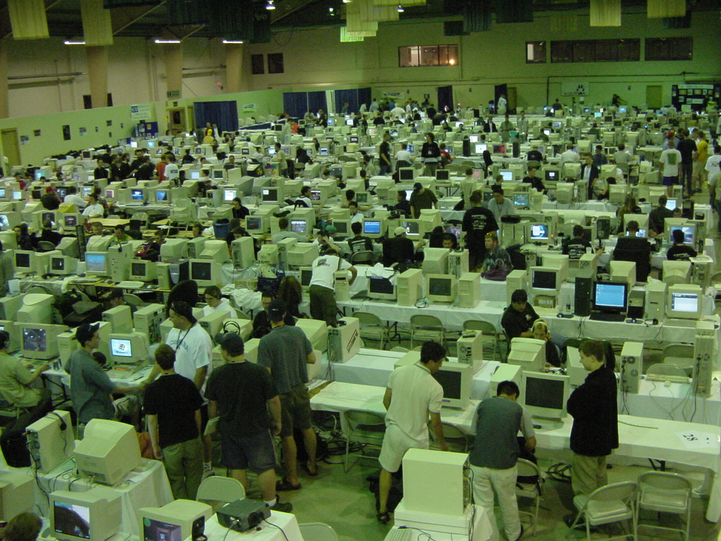
How Does a Computer Work?

Slide 5
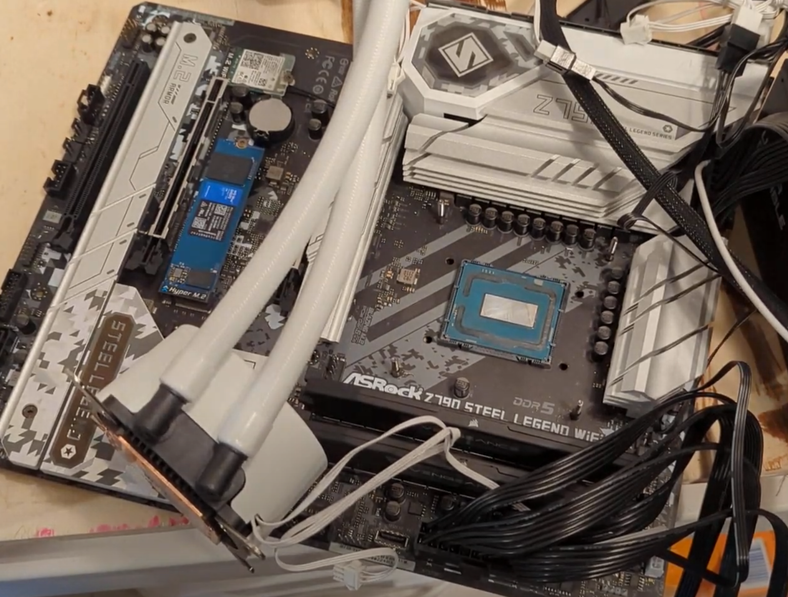
How Does a Computer Work?

Slide 6
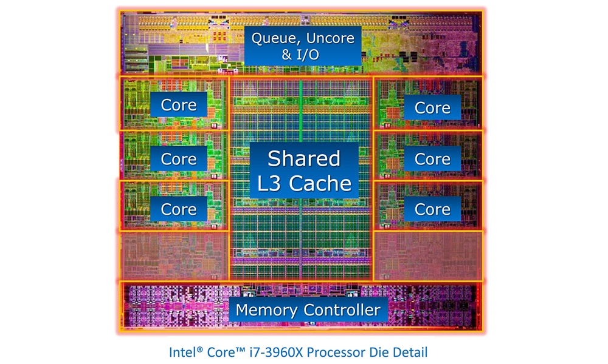
How Does a Computer Work?

Slide 7
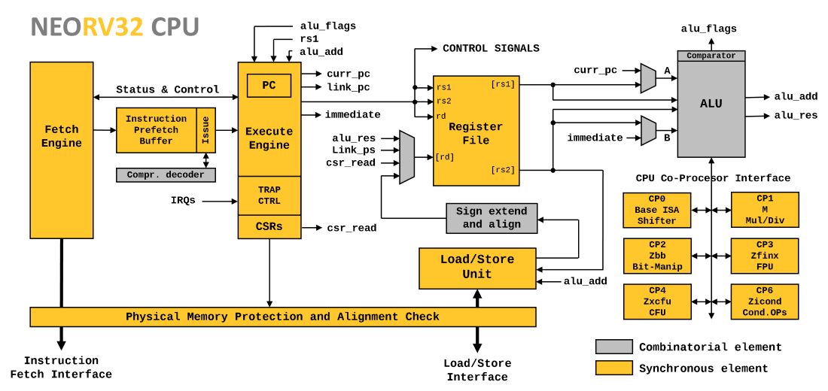
How Does a Computer Work?

Slide 8
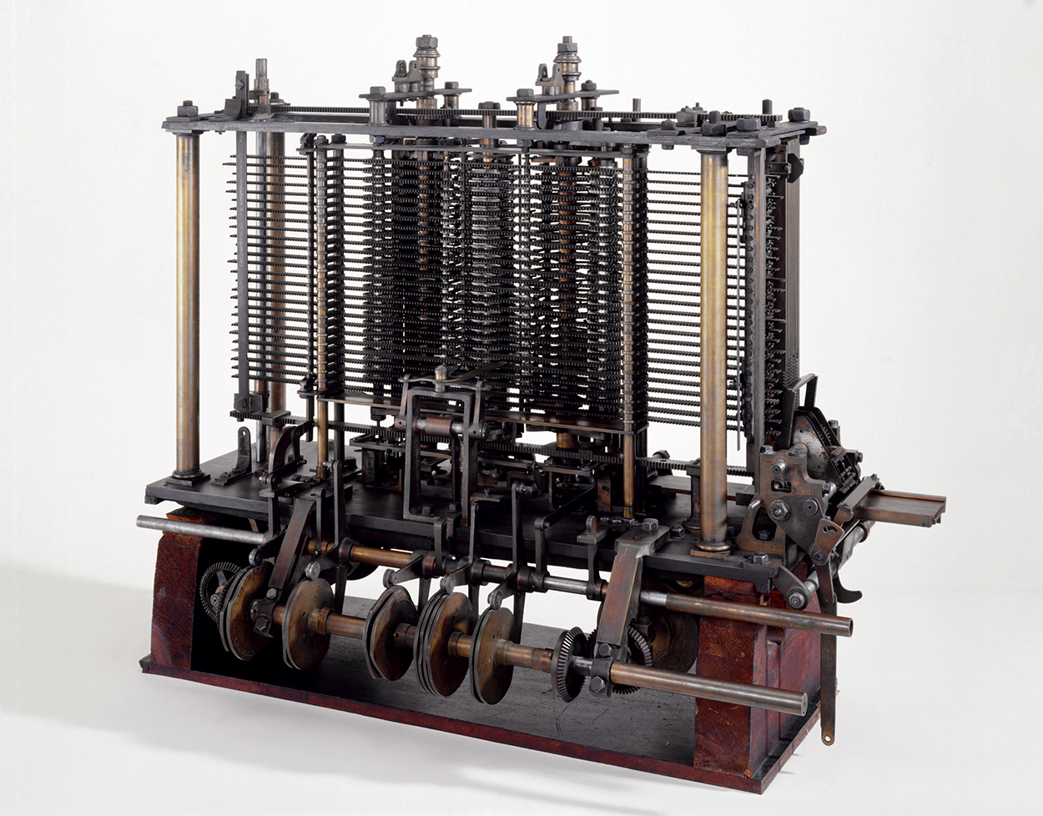
What Is A Computer?

Slide 9
Course & Topic Plans
How Programs Run:
Compilers & Infrastructure
Linkers & Libraries
Assemblers
Machine Code
Debuggers
Performance Measurements
Instruction Set Architectures
Memory & Addressing
The ALU & Flags
The CPU Core
Pipelines
Exceptions
Caches
Peripherals & Busses
Memory Safety
Modern Architectures & Devices

Slide 10
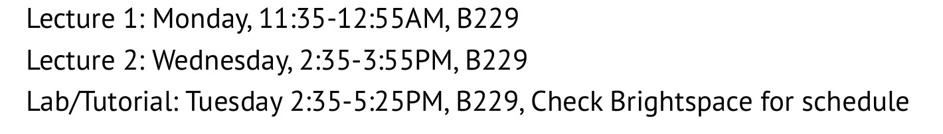
Course Times / Dates

Slide 11
Course Policies
If Dalhousie is closed due to snow event I will not send a notice, there is no class. If we have many cancellations I may need to record missing lectures (there is some “flex” built in right now) or will use Tutorial times.
If class will be cancelled for other reasons I will use Brightspace to announce this.
Lab/Tutorials tend not to run every week – look for a Brightspace announcement to confirm if a lab is running (NO LAB next week).

Slide 12
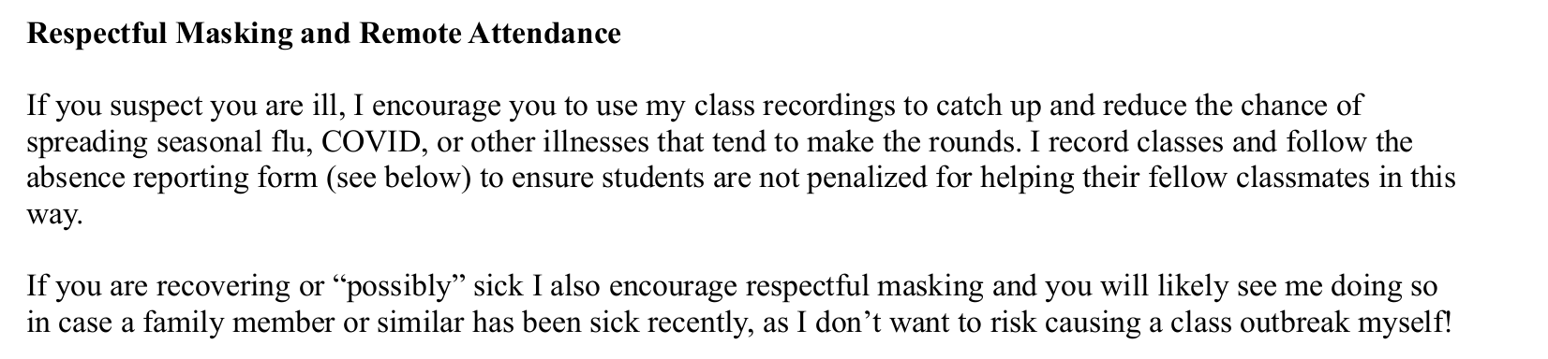
Course Policies (From Syllabus)

Slide 13
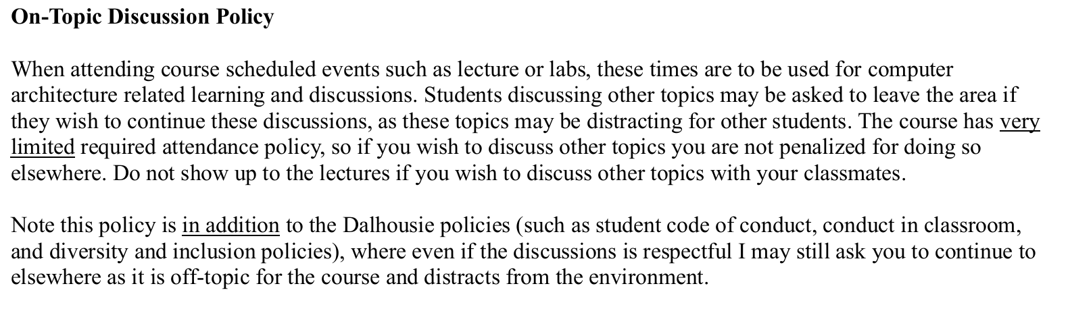
Course Policies (From Syllabus)

Slide 14
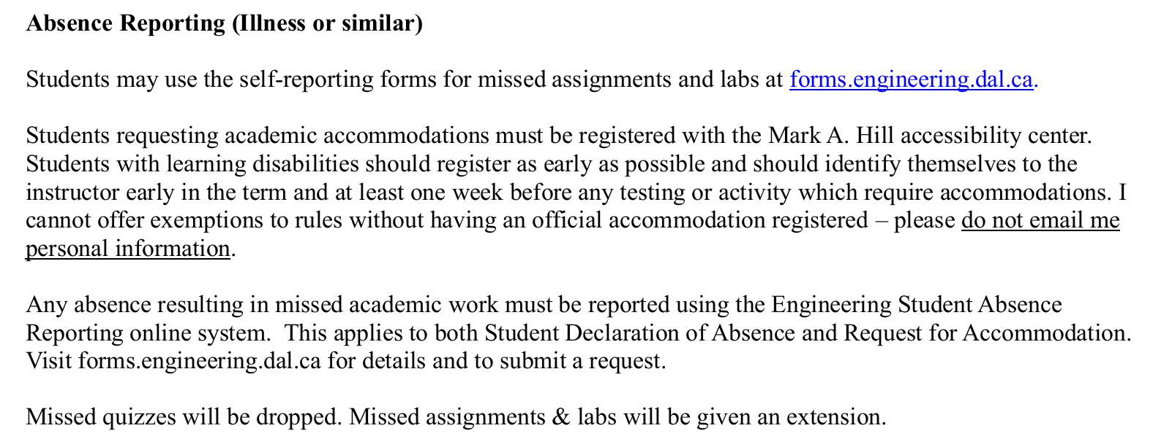
Course Policies (From Syllabus)

Slide 15
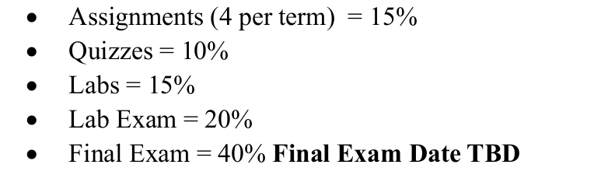
How You Are Evaluated
From the syllabus:
HINTS:
The “Lab Exam” material closely follows the labs
The “Final Exam” material closely follows the assignments

Slide 16
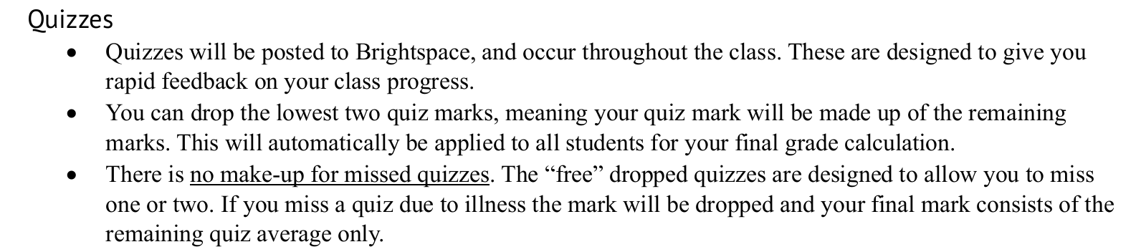
Quizzes
Summary: If you do all the quizzes you should get close to 100% on this topic. Some will be trickier than others (there is a “free” one this week…).

Slide 17
Labs & Assignments
There are four Labs & four Assignments in this course.
They are in practice combined – each Lab/Assignment is around a specific topic.
A practical aspect is done in a more group / interactive environment (the “Lab”).
An assignment aspect is done individually and submitted as a normal assignment.
All Labs will run on your laptop – you will be provided a development board.

Slide 18
Lab Topics
Lab 1: Compiler Infrastructure
Lab 2: Debuggers, Performance Evaluation
Lab 3: Instruction Architecture, Microarchitecture, Caches, and Memory
Lab 4: Interrupts & Exception Handling
(Subject to change)

Slide 19
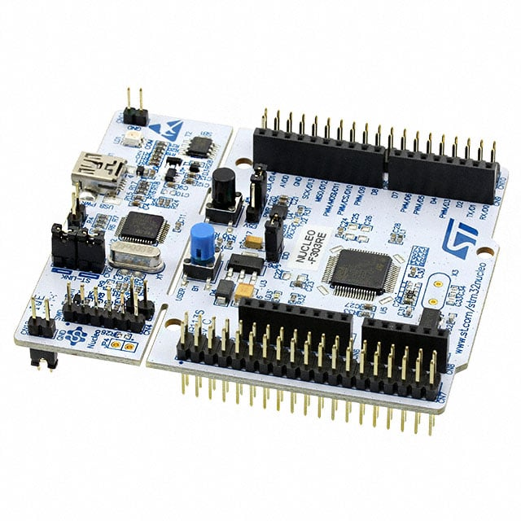
STM32 Nucleo Development Board

Slide 20
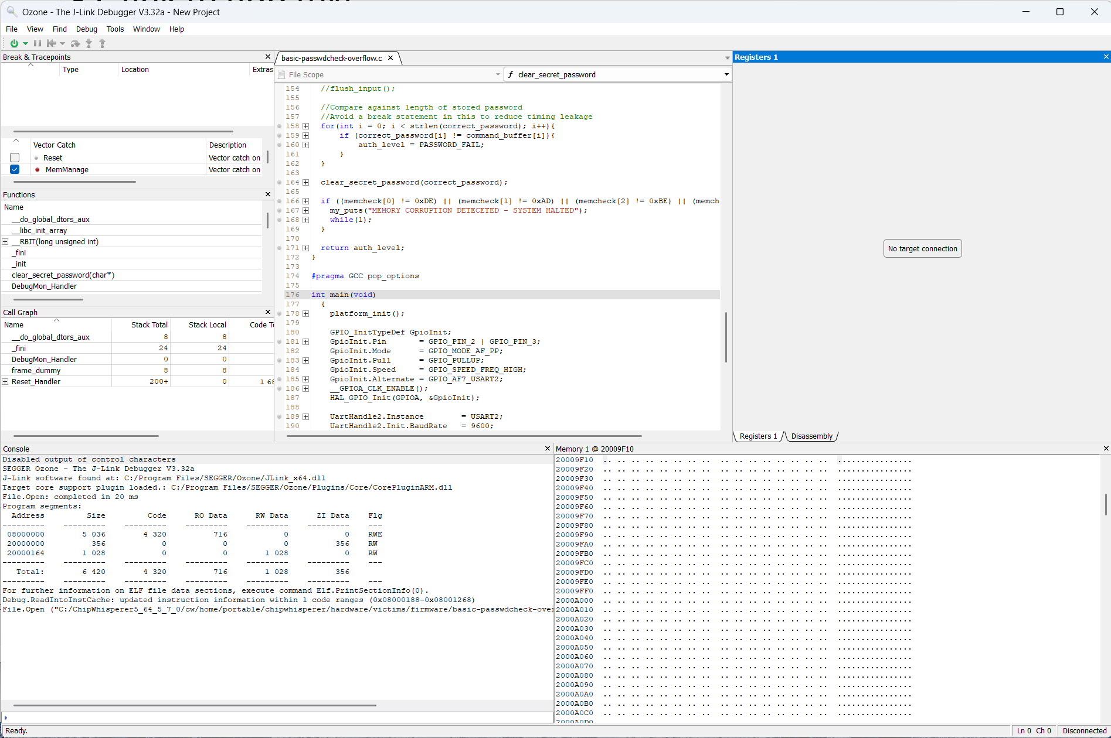
Ozone Debugger

Slide 21
Ozone Debugger
<Live Demo If Working>

Slide 22
Notes on Quizzes, AI, and Final Exam(s)
I follow Dalhousie’s AI policy – work submitted should be your own (see syllabus for full statement).
AI / LLM can be a very useful tool – it has limitations and I’ll be showing you some of these as part of the class. Understanding how to use a tool and when/where to use it is a core part of engineering.
I use the Final Exam as a validation of your personal knowledge – if you have completed assignments/labs yourself you’ll find them easy, if using AI to complete assignments you’ll find them difficult.

Slide 23
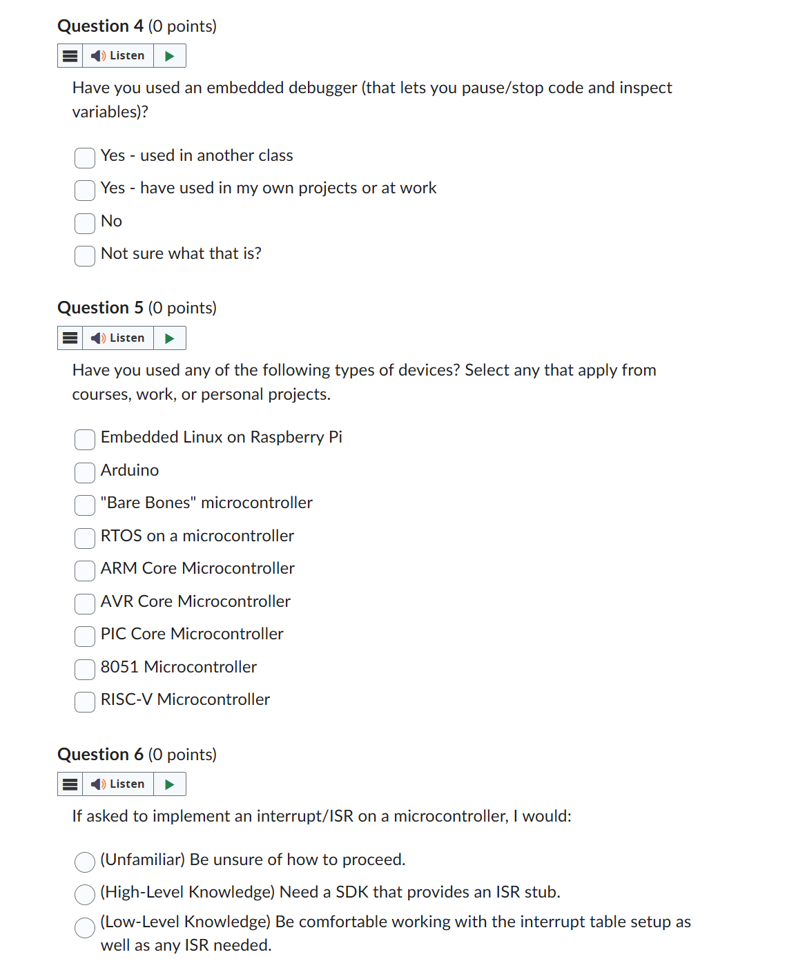
Homework: Quiz 1
Please do “Quiz 1” ASAP.

Slide 24
Course Questions For Me
Questions or Concerns?
coflynn@dal.ca
If not we’ll pick this up on the first “normal” lecture day to introduce the first topic.

